Slide 1

Create and use forms
Week 8

Slide 2
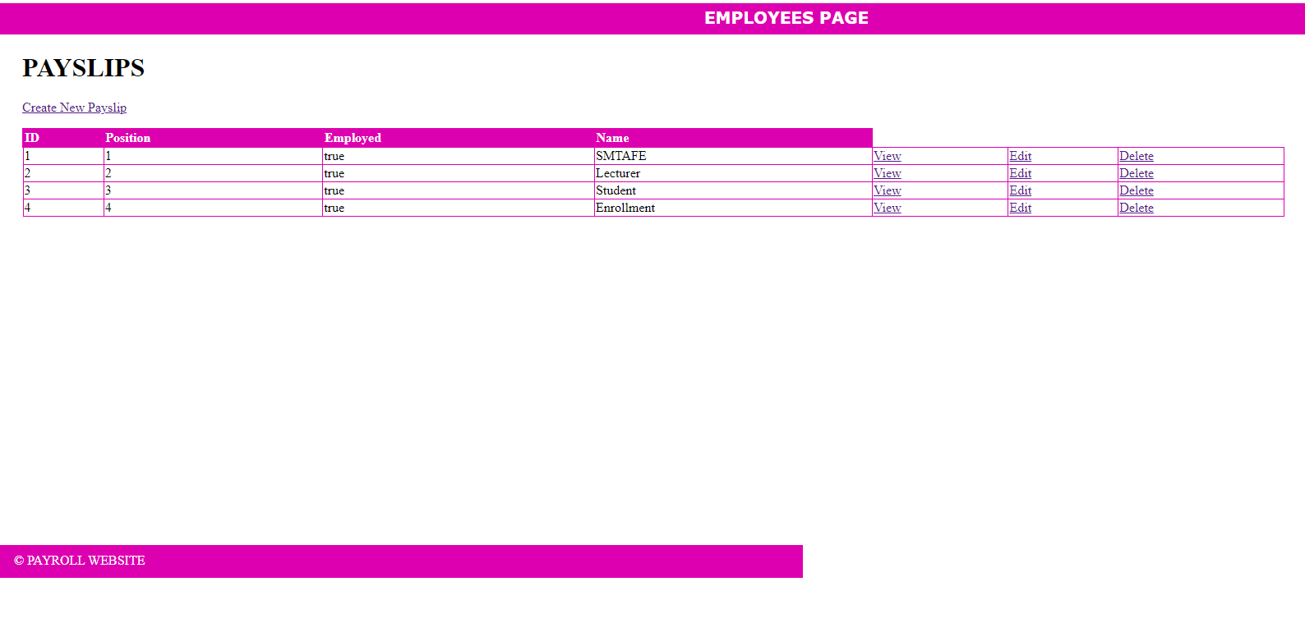
Objectives
Learn about global variable Get
Learn about global variable Post
Read server response
Pass id to the next page

Slide 3

Idea:

Slide 4
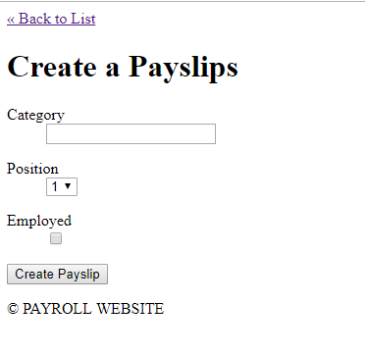
This is our form

Slide 5
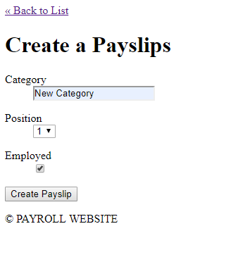
Type values

Slide 6
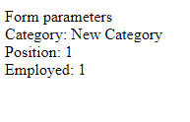

Slide 7
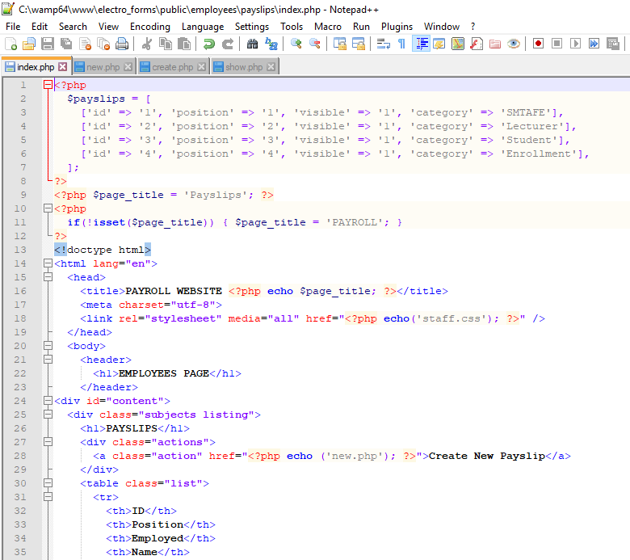
PHP isset() function :
PHP isset() function is used to check if a variable has been set or not.
This can be useful to check the submit button is clicked or not.
The isset() function will return true or false value. The isset() function returns true if variable is set and not null.

Slide 8
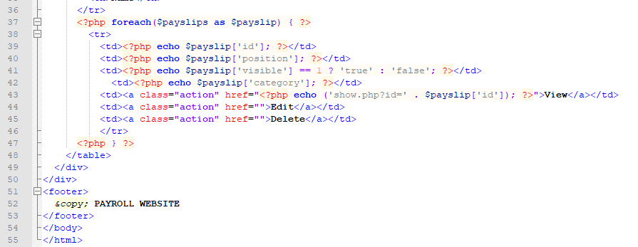

Slide 9
html { height: 100%; width: 100%; } body { height: 100%; width: 100%; margin: 0; padding: 0; } header { width: 100%; height: 4%; margin: 0 0 10px 0; padding: 0; background: #dd00b0; color: white; } header h1 { margin: 0; padding: 5px; font-size: 20px; font-family: Verdana, Arial, Helvetica, sans-serif; text-align: center; }
navigation { width: 100%; margin: 0; padding: 0; text-align: center; } navigation ul { width: 100%; list-style: none; padding: 0; margin: 0; } navigation ul li { display: inline; margin-right: 2em; } #content { width: 80%; min-height: 600px; padding: 0 30px; } footer { width: 940px; height: 20px; margin: 0 0 10px 0; padding: 10px 20px; background: #dd00b0; color: white; }
/* Actions */ .actions { margin-bottom: 1em; } /* Lists */ table { border-collapse: collapse; vertical-align: top; } table.list { width: 100%; } table.list tr td { border: 1px solid #dd00b0; } table.list tr th { border: 2px solid #dd00b0; background: #dd00b0; color: white; text-align: left; } /* Forms */ dl { clear: both; overflow: hidden; margin: 0.5em 0; } dt { float: left; font-weight: bold; width: 125px; }
dd { float: left; margin-left: 1em; } #operations { clear: both; margin: 1em 0 1em 75px; }
Staff.css

Slide 10
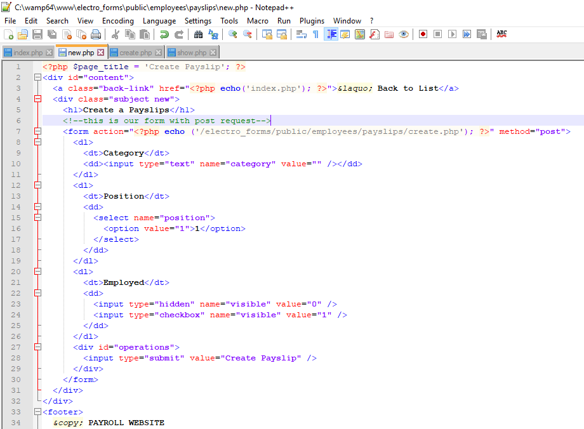

Slide 11
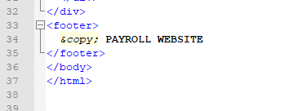

Slide 12
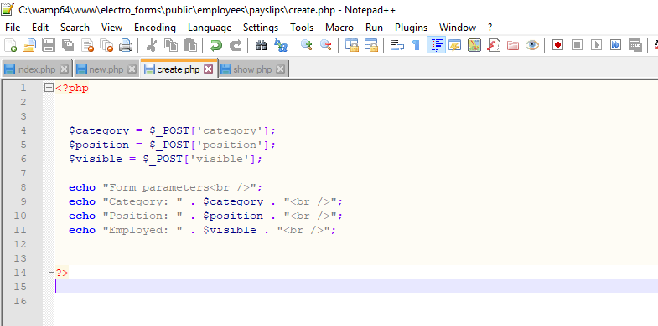

Slide 13
